Slide 1
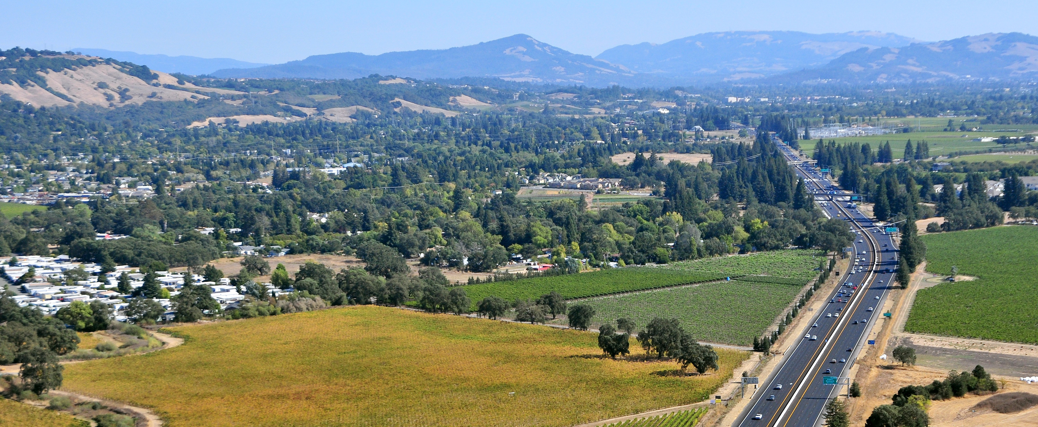
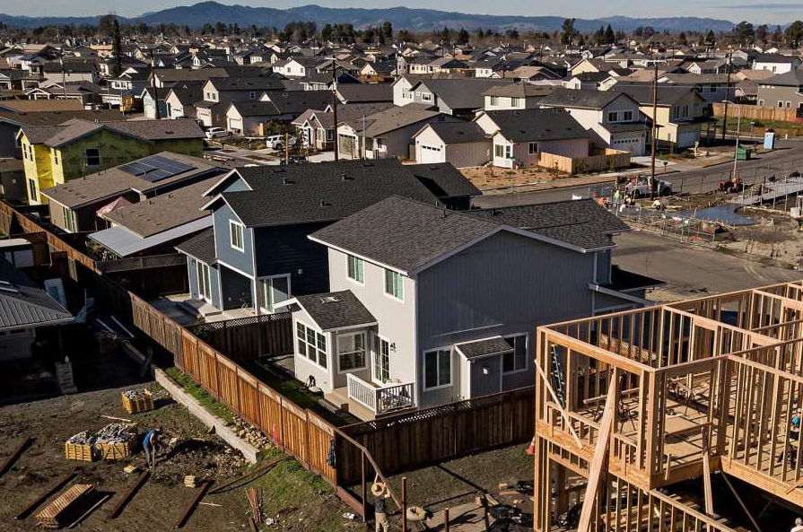
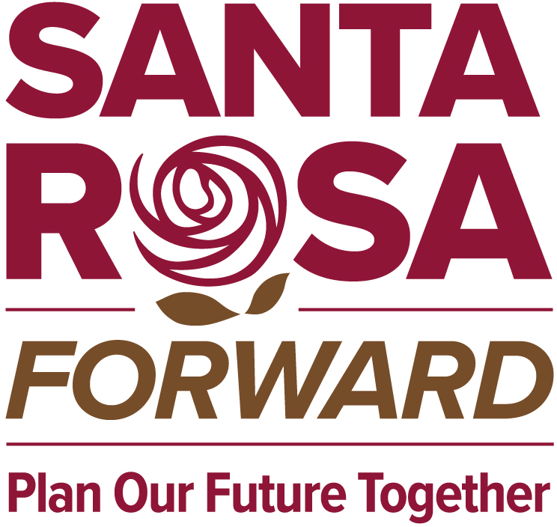
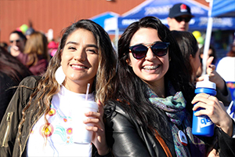
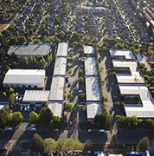
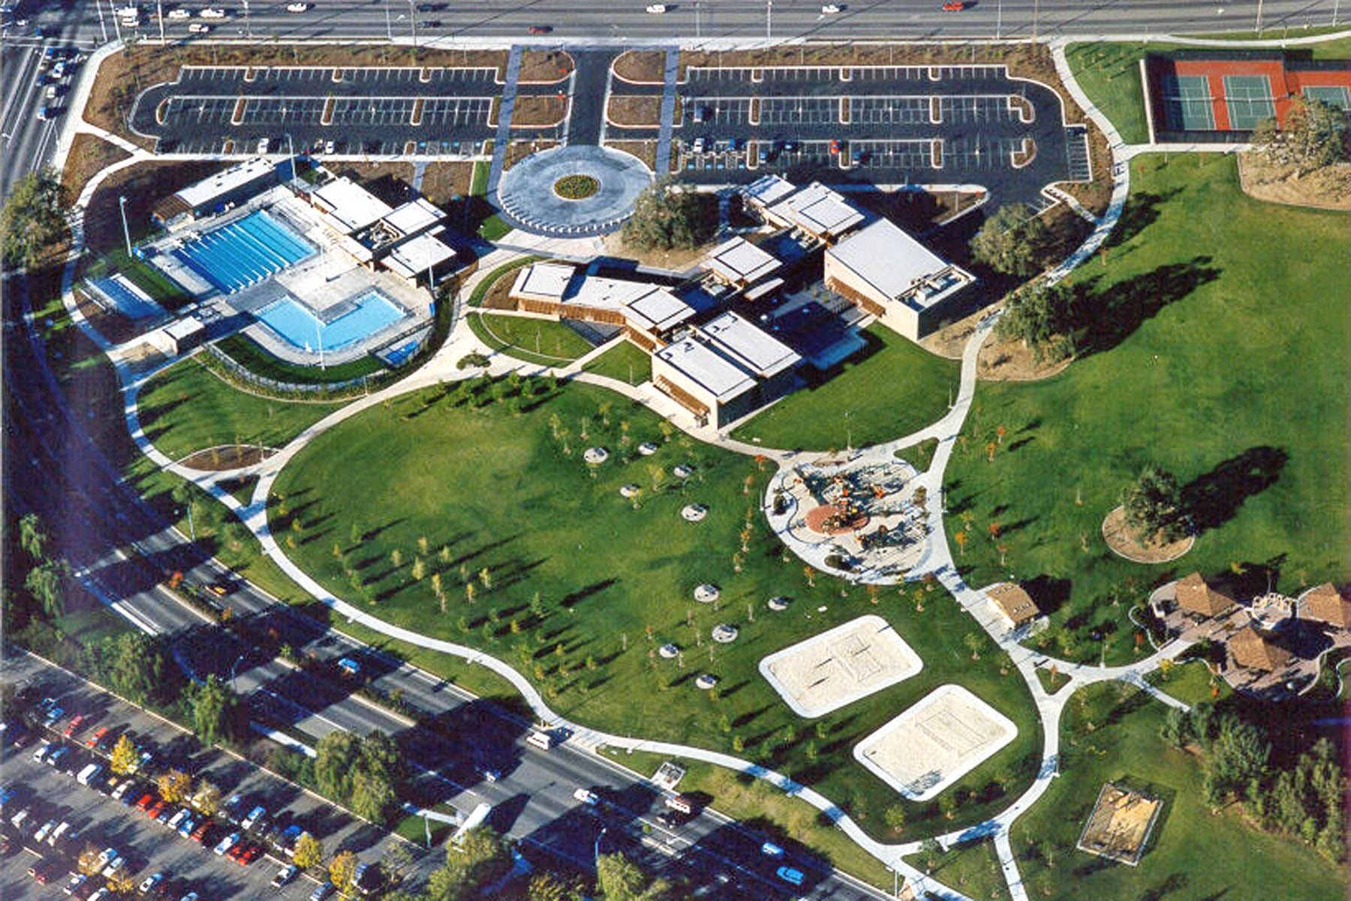
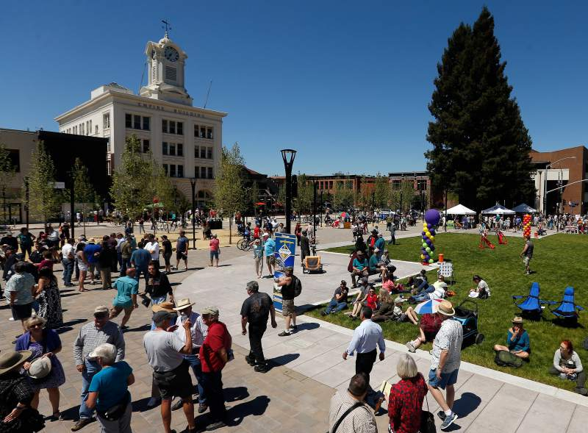
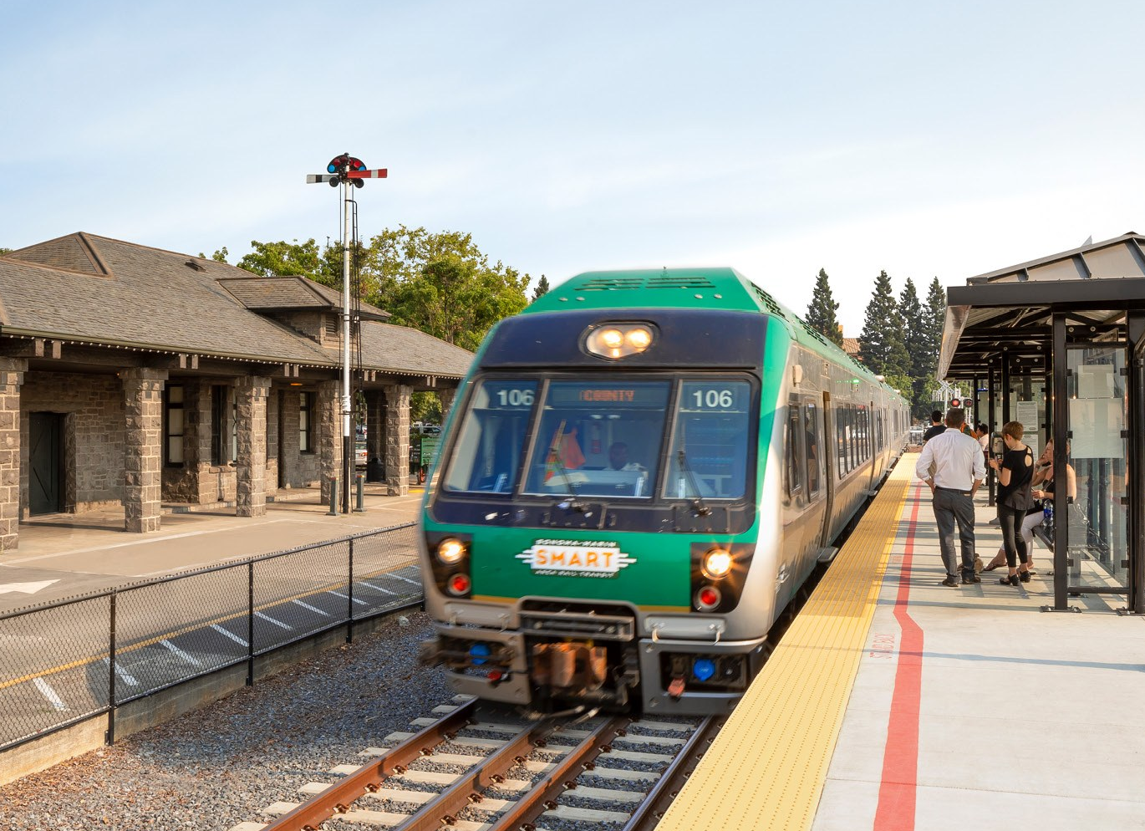

WELCOME!
THE VIRTUAL WORKSHOP WILL BEGIN SHORTLY
COMMUNITY VISION WORKSHOP | MAY AND JUNE 2021
Notes:
Transparency
Equal Participation
Inclusivity
Respectful Engagement
Facilitated Meetings
Decision Making

Slide 2
The City of Santa Rosa is committed to creating a safe and inclusive environment free from disruption. We will not tolerate any hateful speech or actions and are well staffed to monitor that everyone is participating respectfully (or they will be removed). If necessary, we will also immediately end the meeting. If the meeting is ended, we will plan on recording another presentation without participants that will be posted on the project website.
Today’s meeting is being recorded
Notes:
LOGISTICS LEAD
Welcome everyone. Before we begin the workshop, I would like to highlight some rules for this evening’s discussion.
[read slide]

Slide 3
ZOOM ORIENTATION

Slide 4
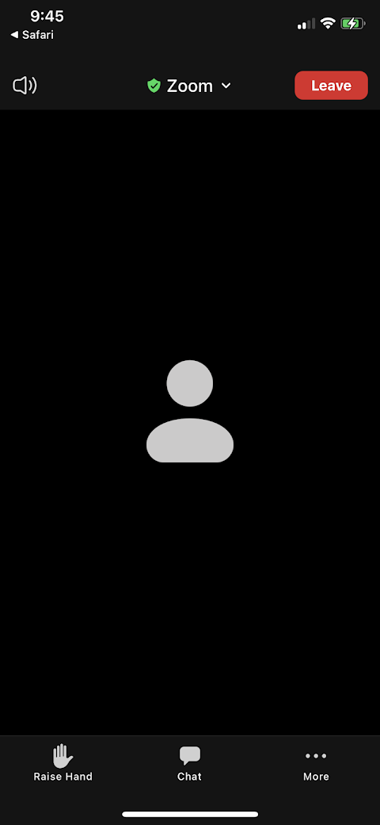
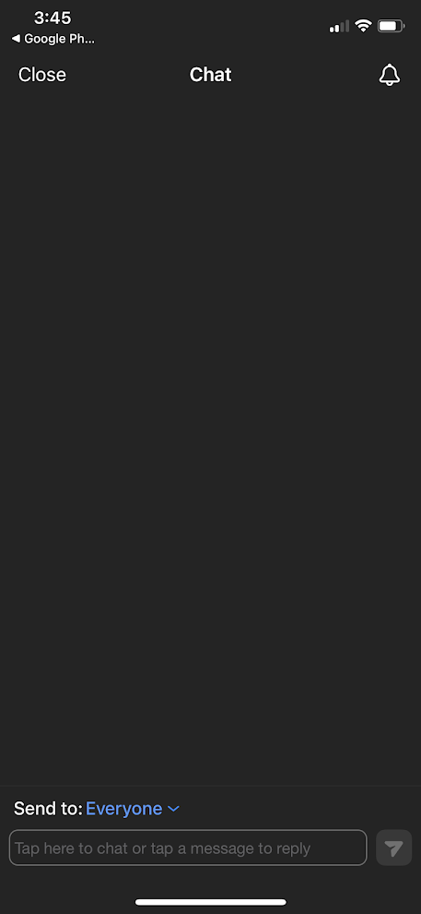
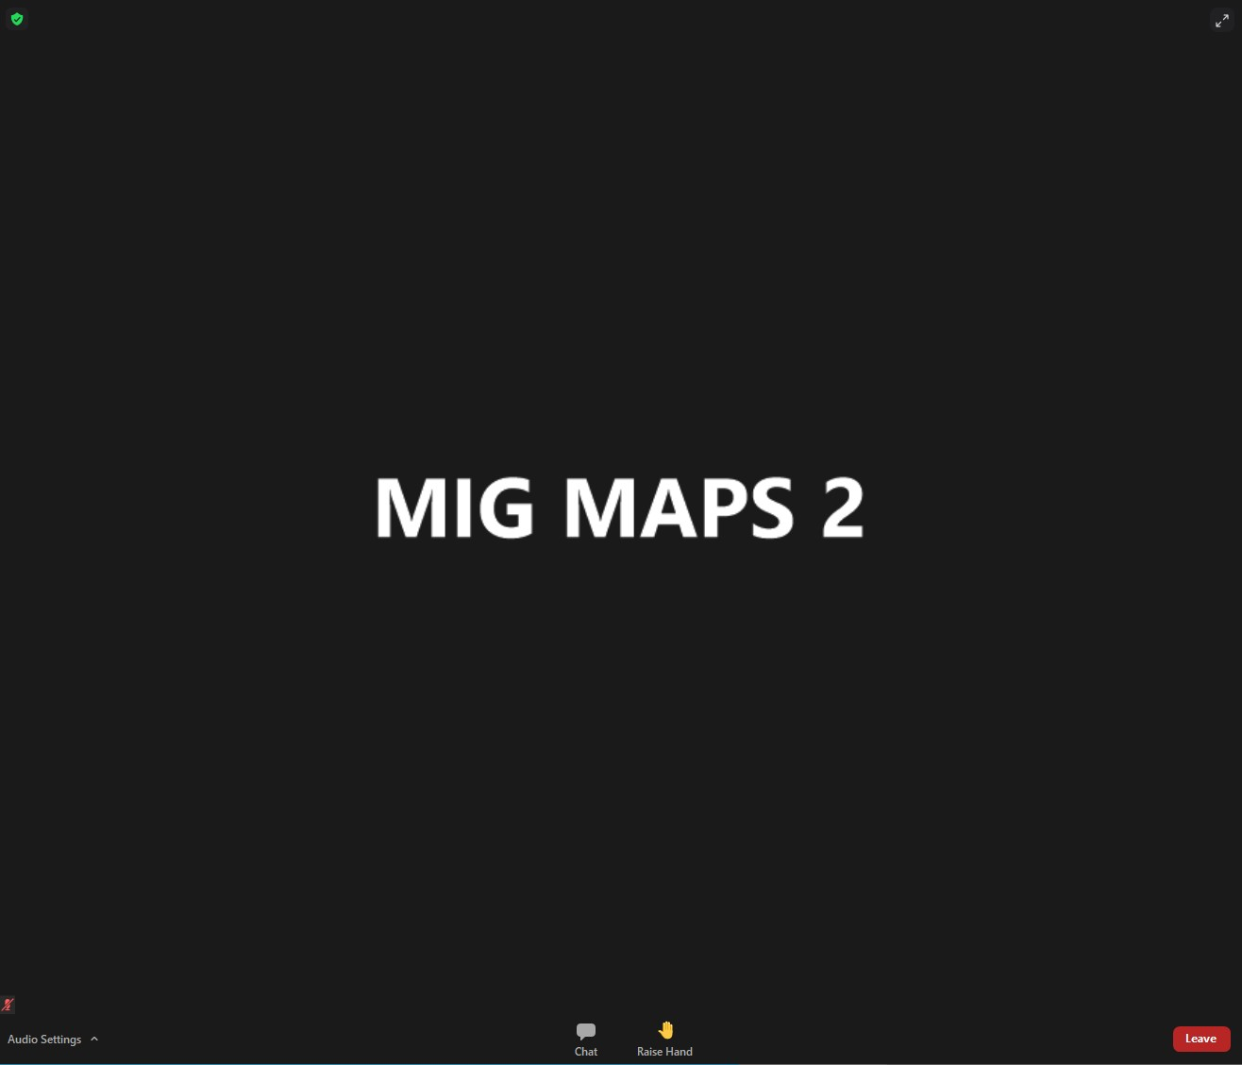
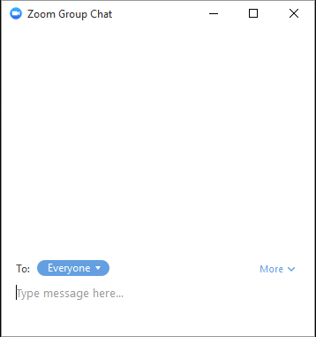
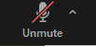
Zoom Chat
Phone
Computer
Click Raise
Hand
Type Comment Here
Type Comment Here
Click Raise
Hand
Click Chat

Slide 5
Virtual Participation Agreement
The workshop will include several sections with pause points to ask questions and provide comments
Be respectful of one another’s opinions
We will try to answer all questions today, but may need to follow-up with more detailed responses after the session
Remember this is just one workshop in a longer process
Notes:
update

Slide 6
WELCOME &
AGENDA REVIEW

Slide 7
Workshop Agenda
Welcome & Overview
Santa Rosa Forward Process
Draft Vision Elements
Discussions
Next Steps & Close
Notes:
I. Welcome and Agenda Review……….6:00 PM
II. Introductions……………………………......6:15 PM
▪ City Staff and Consultant Team Members
▪ Community Advisory Committee Members
III. Community Advisory Committee Purpose and Roles…….………………….6:50 PM
▪ Organizational Framework
▪ Key Responsibilities
▪ Brown Act Requirements
IV. Santa Rosa Forward Project Overview and Key Themes……………7:20 PM
▪ Project Overview
▪ Purpose and Role of a General Plan
▪ Community Involvement Strategy
▪ Existing Conditions Key Findings
▪ Initial Project Themes
▪ Overall Project Schedule
V. Public Comments………………..……….7:50 PM
VI. Close………………….…………………….…8:00 PM

Slide 8
SANTA ROSA FORWARD PROCESS

Slide 9
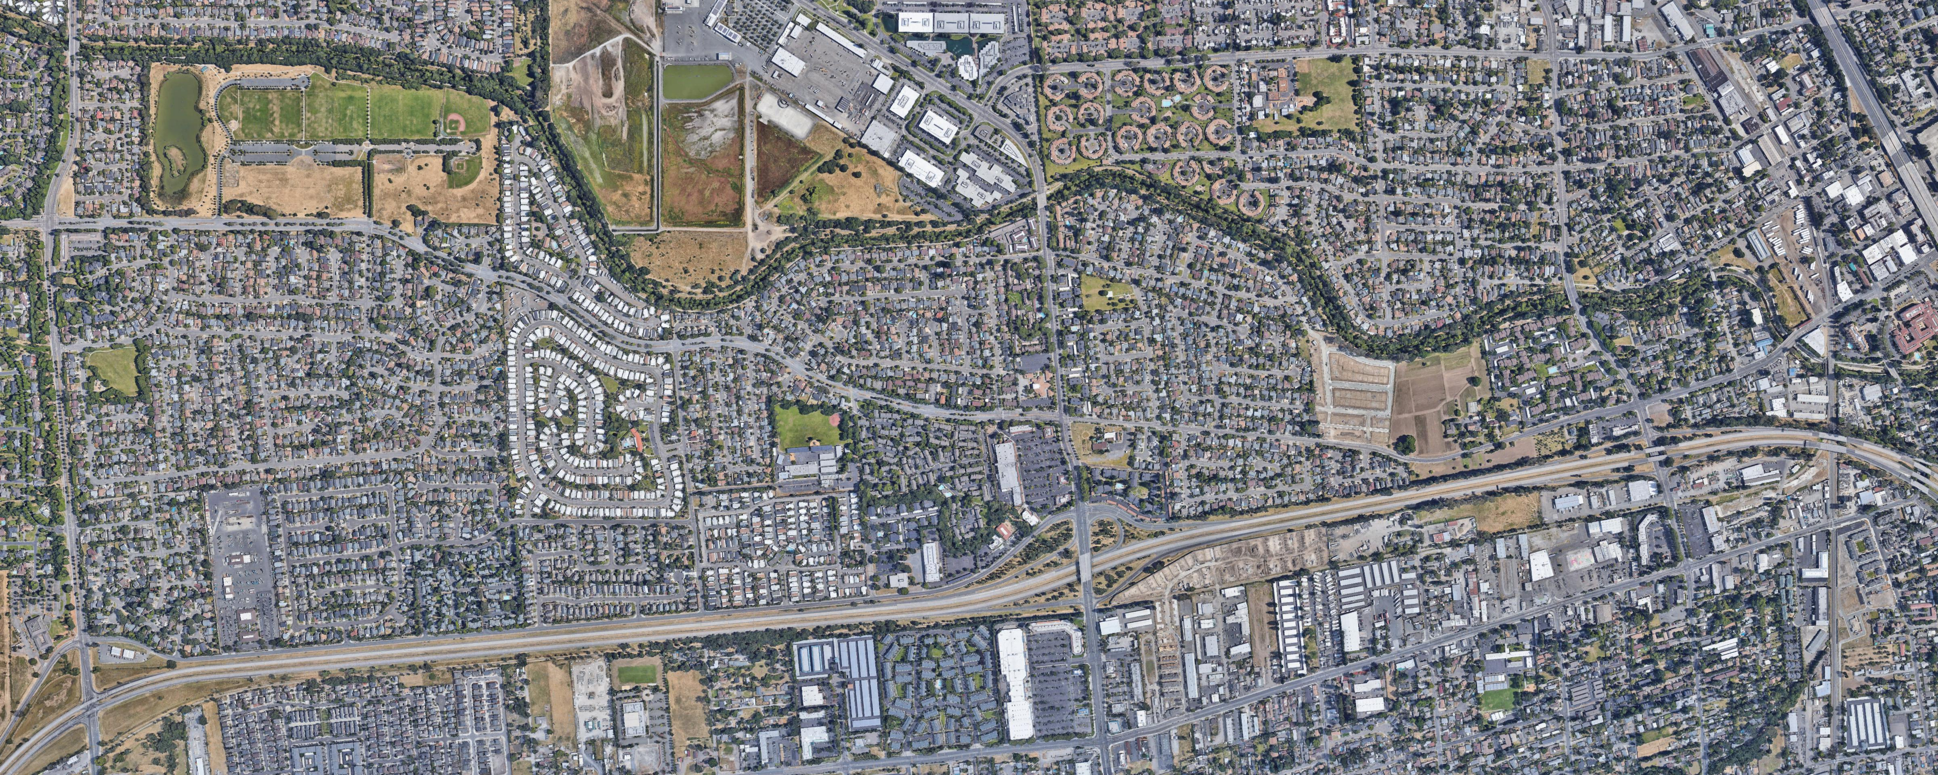
Communities are planned by thinking about where homes, buildings, stores, parks, schools, roads, and other features should be located and how they relate to each other.
BUSINESSES/JOBS
PARKS
TRAILS AND OPEN SPACE
DOWNTOWN
ROADS
NEIGHBORHOODS
NEW NEIGHBORHOODS
SCHOOLS
STORES
FREEWAYS
SHOPPING CENTERS

Slide 10
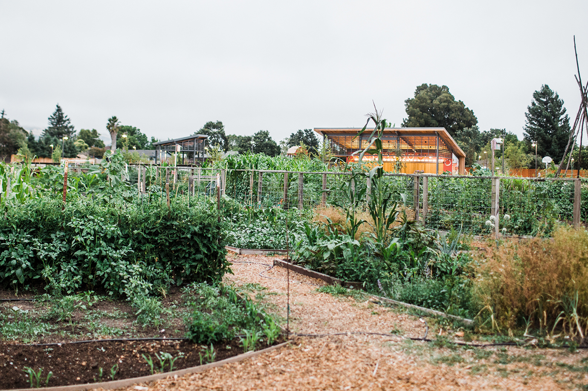
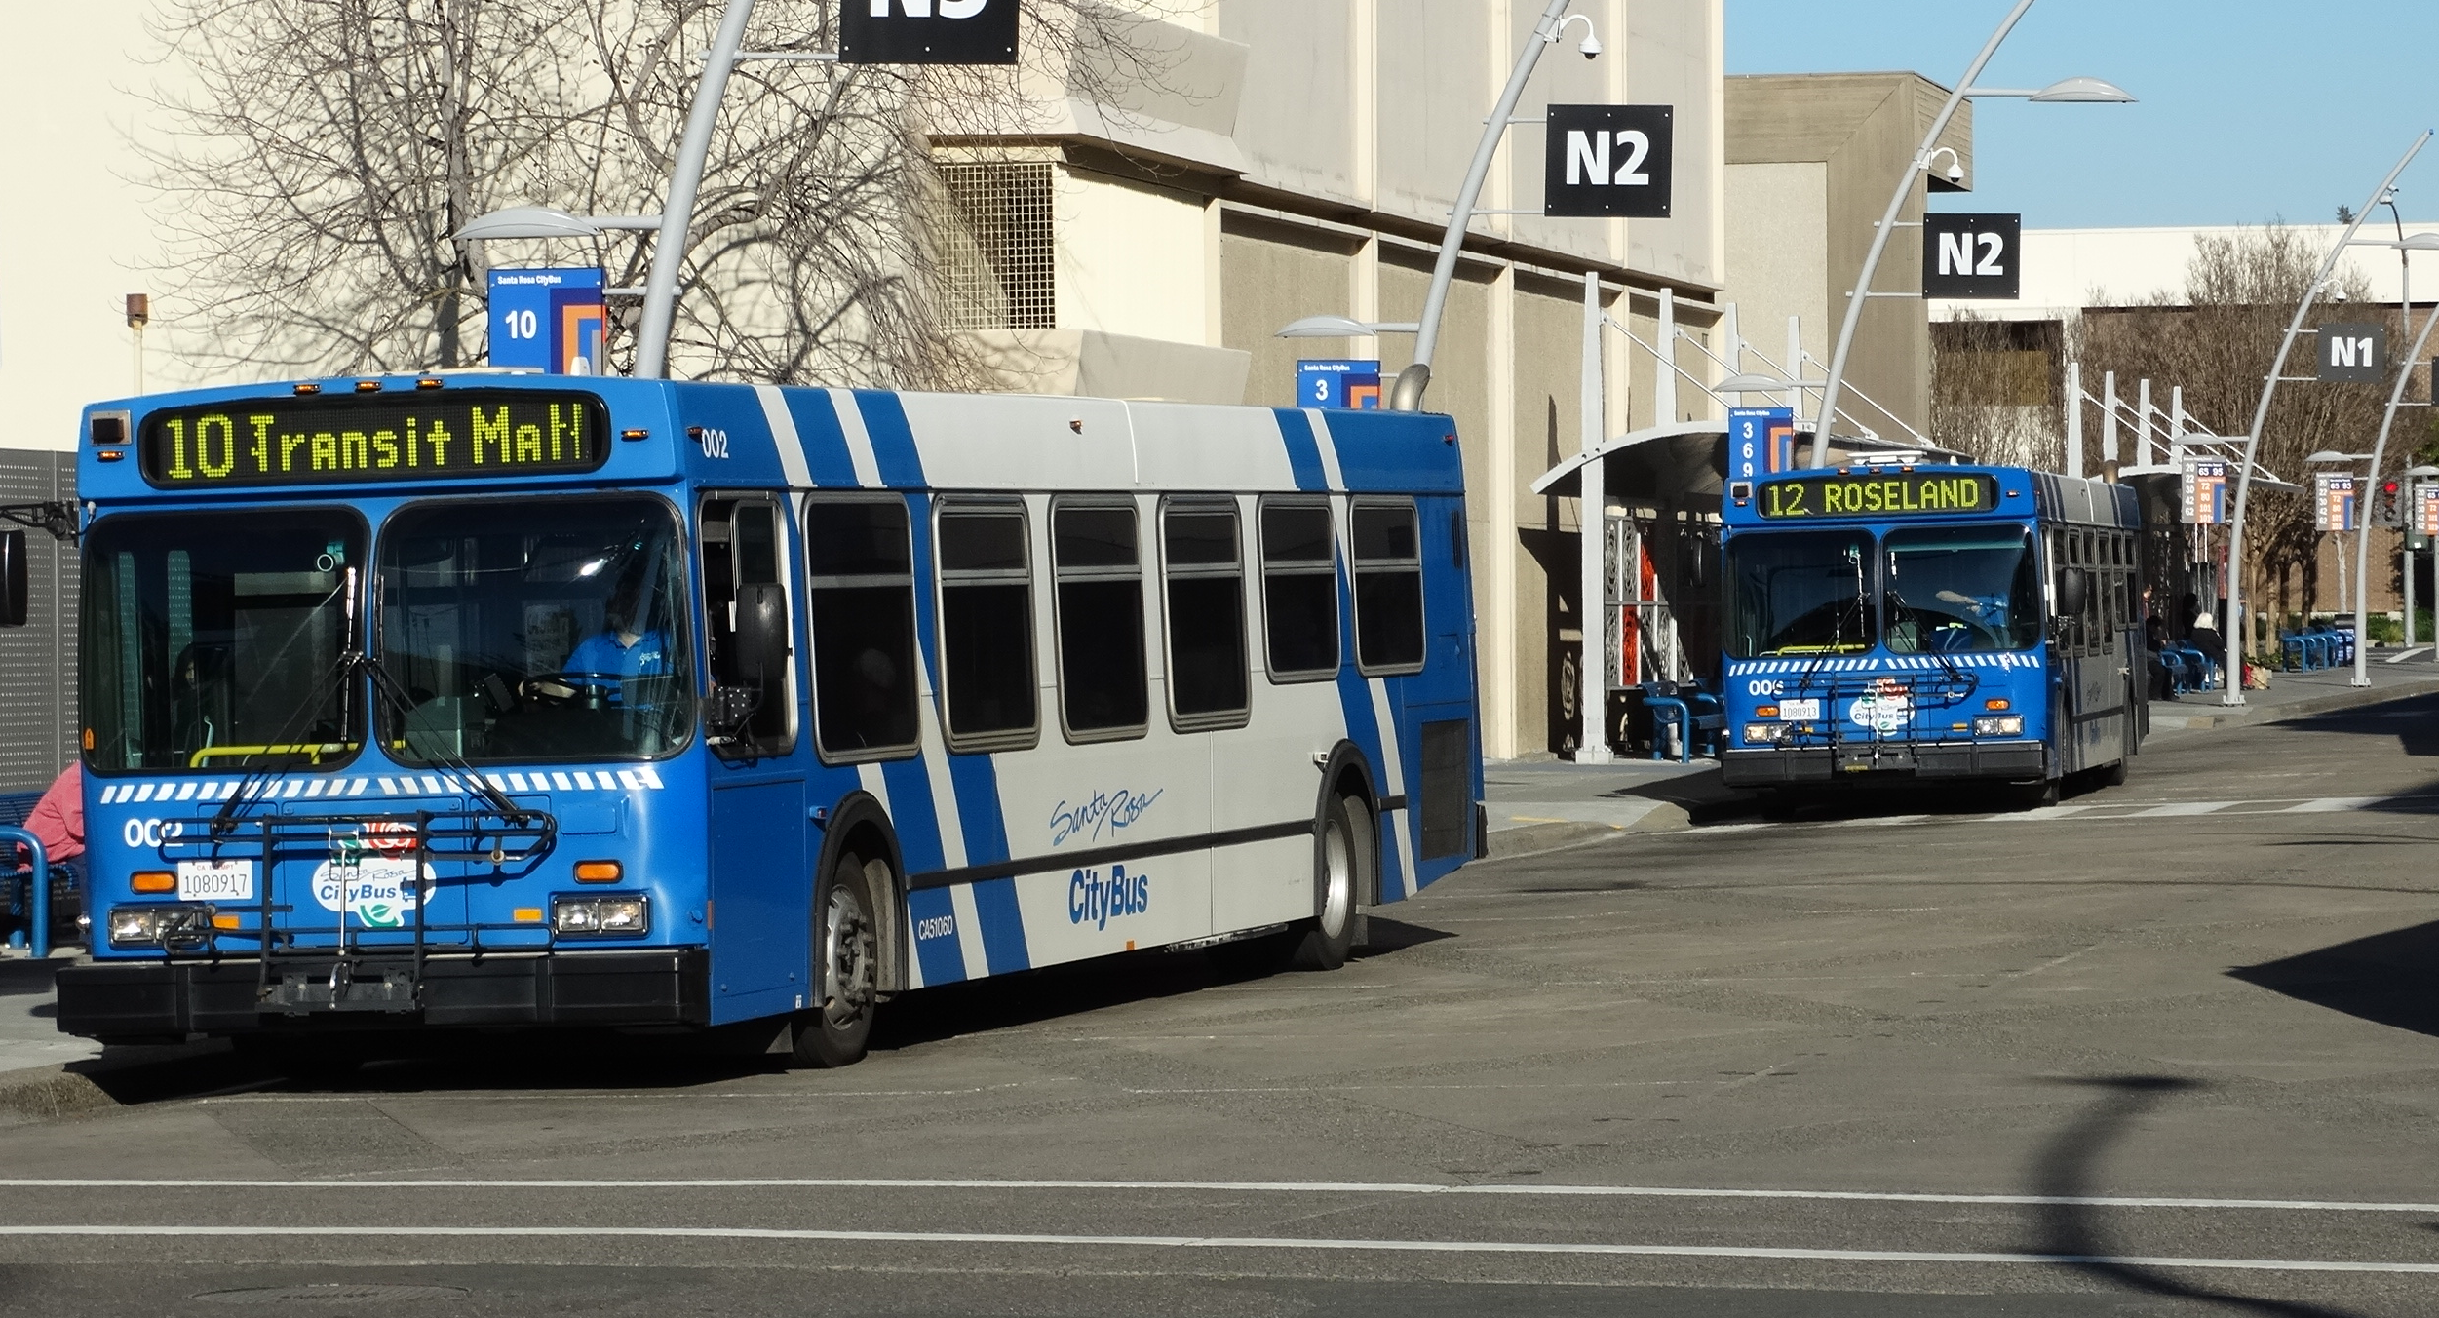
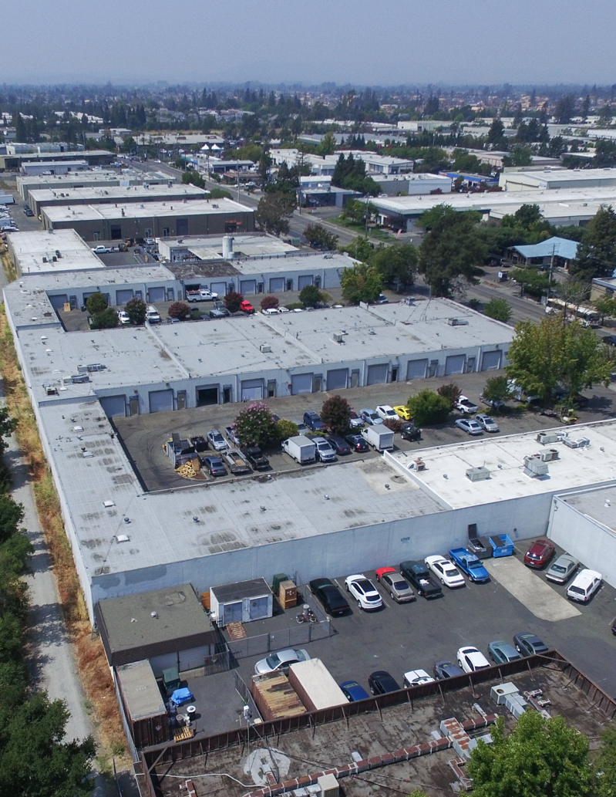
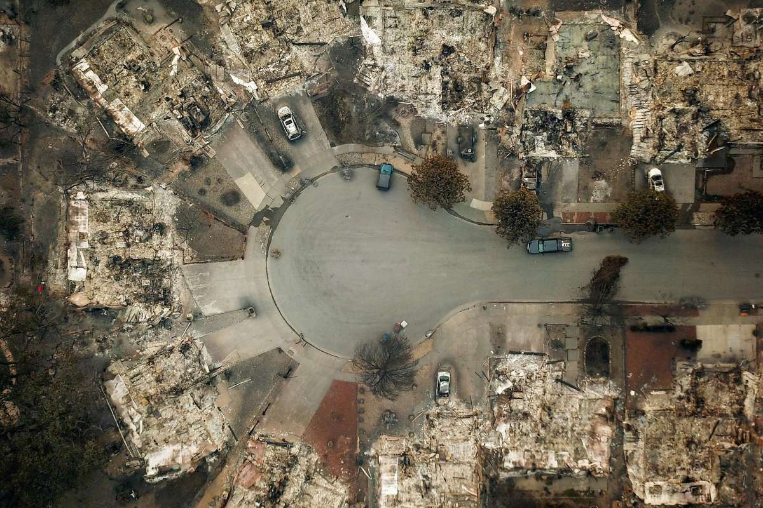
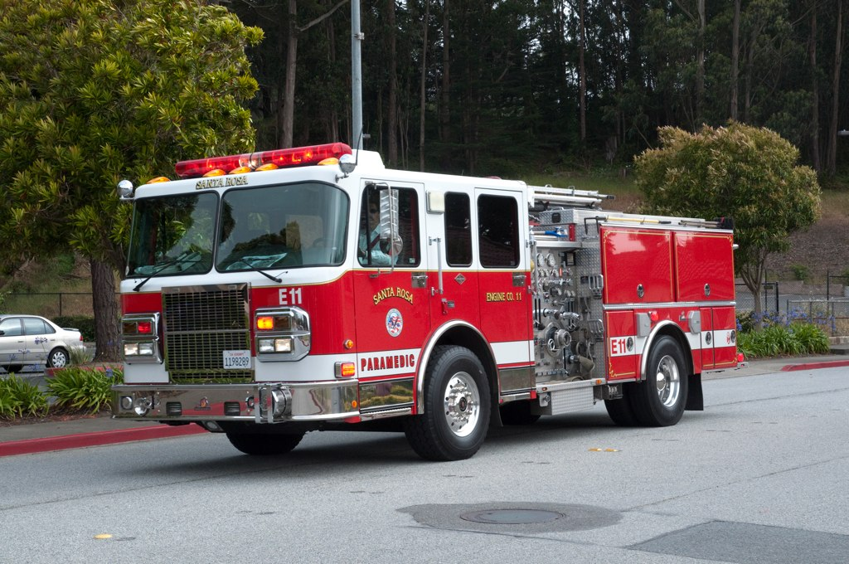
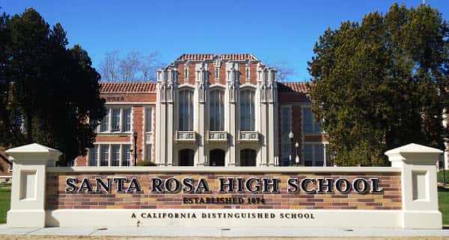
But planning also involves thinking about what people need and how they can stay safe, have access to education and jobs, and have a voice in decisions that affect their lives.

Slide 11
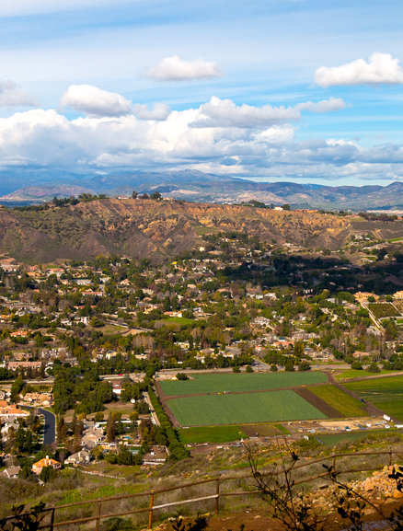
The General Plan Update process, known as Santa Rosa Forward, provides an important opportunity to revisit and rethink community planning policies and programs.
The goal is to think about how we want to improve Santa Rosa now and into the future!

Slide 12
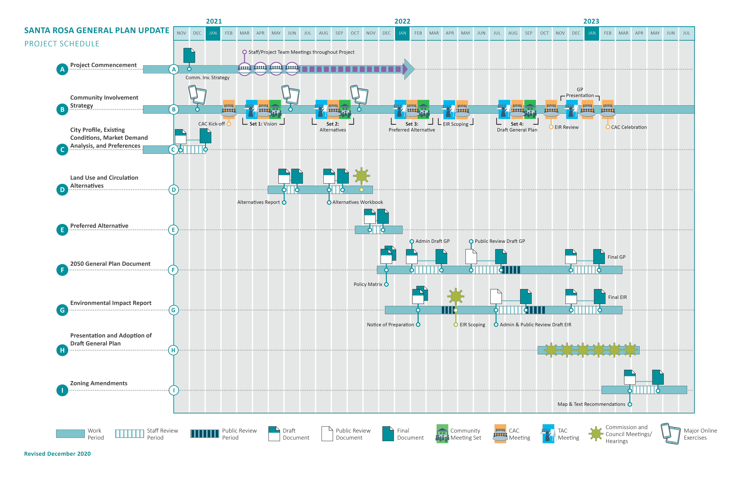

Slide 13
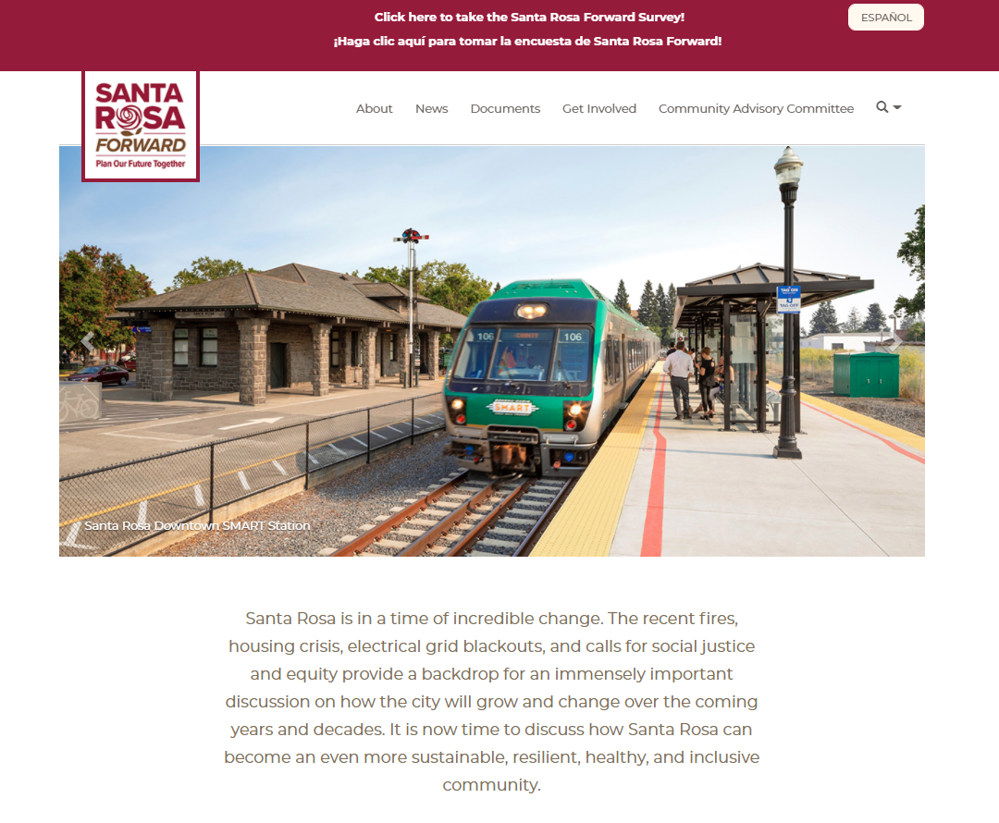
Project Website
Went live in December 2020.
Includes a wealth of project information, documents, and materials.
Also includes a Comment Form, ability to sign up for email updates, and links to the survey.
Notes:
https://www.santarosaforward.com/

Slide 14
Existing Conditions Summary
Published in December 2020 and summarizes the current context in Santa Rosa:
Demographics
Economics
Land Uses
Community Character
Mobility
Natural Resources
Safety
Infrastructure
Environmental Justice
Community Health
Notes:
update

Slide 15
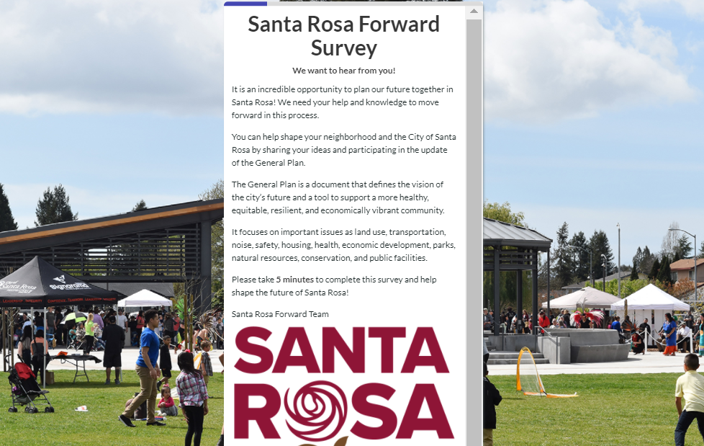
Community Survey #1
Released on February 19, 2021, in both English and Spanish versions.
Over 1,300 Santa Rosans completed the survey!
Notes:
update

Slide 16
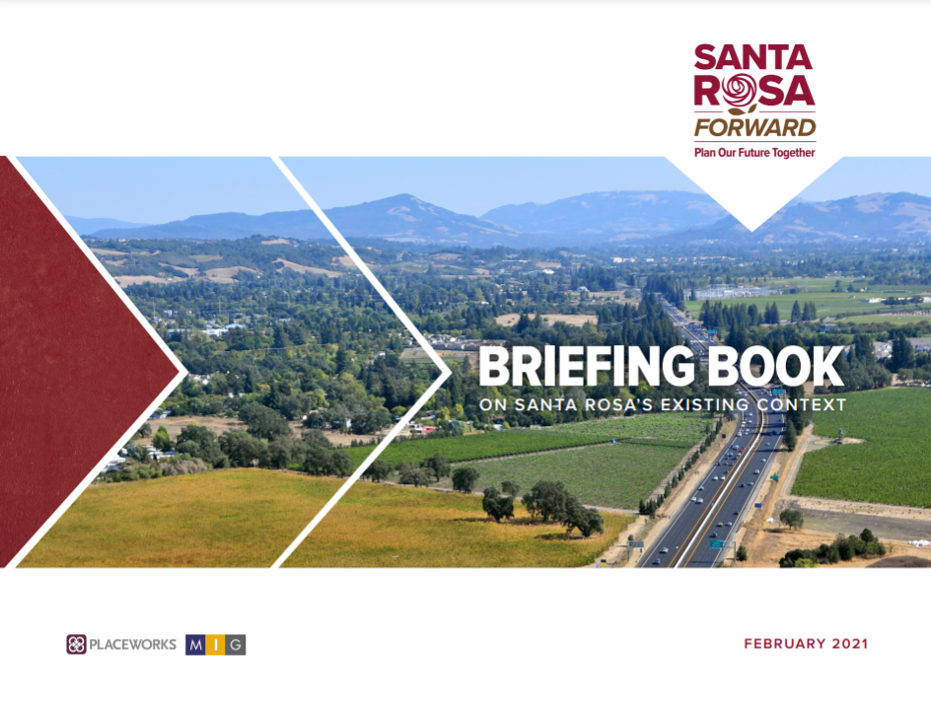
Briefing Book
Published in February 2021 in both English and Spanish versions.
Includes a summary of the major issues, opportunities, and constraints in Santa Rosa
Available at:
www.santarosaforward.com/docs
Notes:
update

Slide 17
Vision Statements
General Plans include Vision Statements as aspirational statements framing community needs and desires.
Vision Statements are important because new or updated goals, policies, and programs in the General Plan will need to reflect them and their direction.
Community Advisory Meeting
Workshops, Meetings, Online Survey, Youth Engagement
Planning Commission and
City Council
Community Survey #1
Technical Advisory Committee Meeting
Vision Statements Refinement Process

Slide 18
DRAFT VISION STATEMENTS

Slide 19
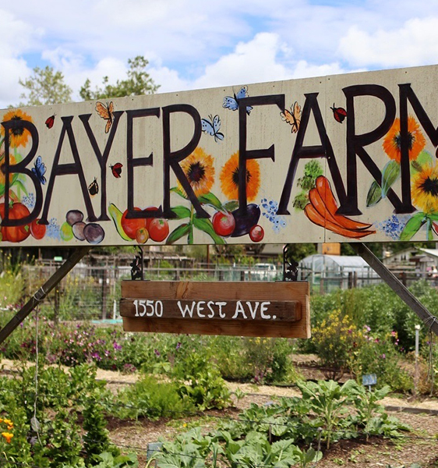
Draft Vision Statements
Inclusive: Everyone is welcome, all people and groups are actively encouraged to join in neighborhood and citywide decision making, and barriers to participation are identified and eliminated.
Just: Social and environmental justice is achieved for all people.
Notes:
update

Slide 20
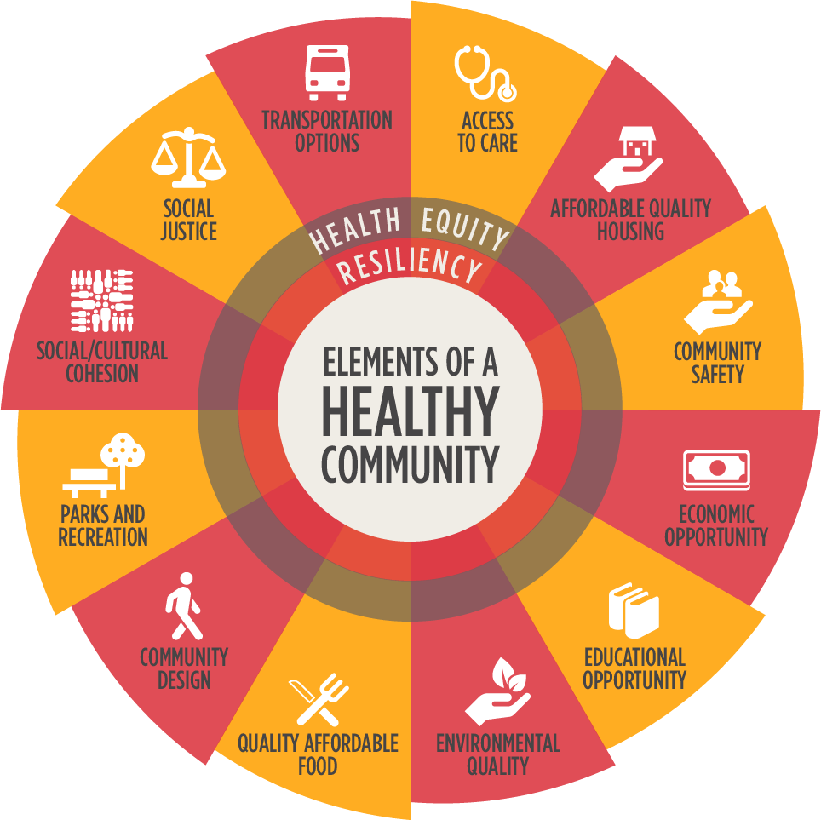
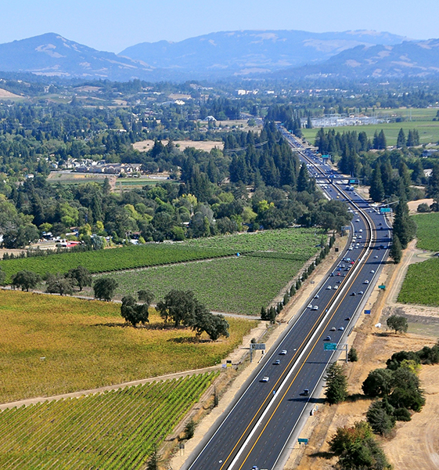
Draft Vision Statements
Healthy: Neighborhoods are healthy, vibrant, full-service communities, anchored by inclusive and accessible public outdoor spaces and buildings offering safe and welcoming places for all groups to gather.
Resilient: All facets of the community, including housing, infrastructure, and social services are sustainable and resilient to economic changes and hazards.
Notes:
update

Slide 21
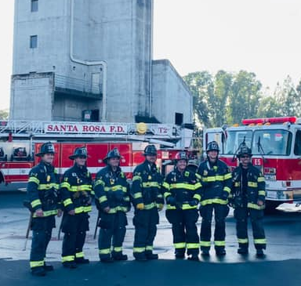
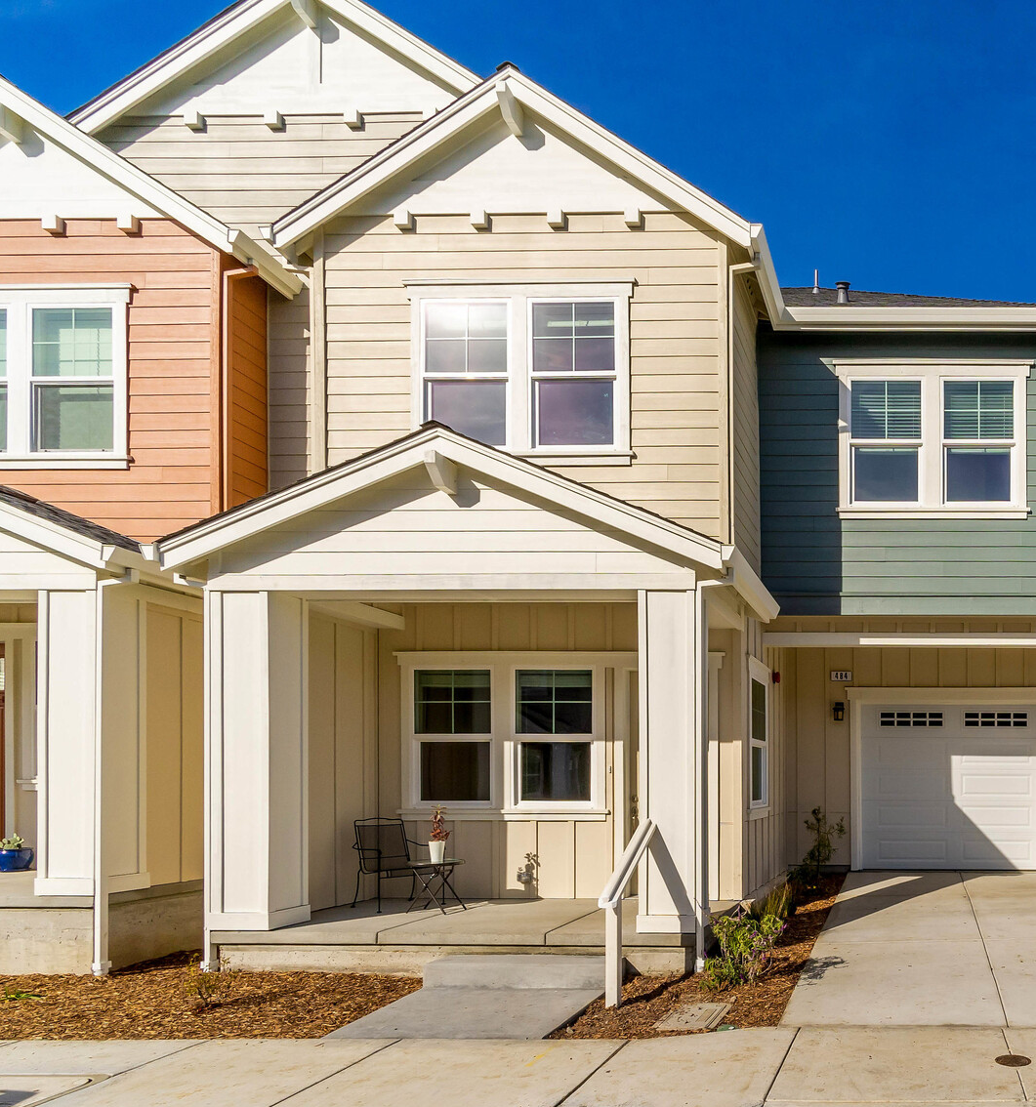
Draft Vision Statements
Prepared: All residents are aware of the risks of natural and human-caused hazards and are engaged in neighborhood and City emergency preparedness efforts.
Sheltered: A diverse mix of high-quality, safe, thoughtfully designed, and well-served housing at all affordability levels is available throughout the community to accommodate everyone, including local workers and formerly homeless residents.

Slide 22
Draft Vision Statements
Equitable: Everyone has convenient and equitable access to meet their daily needs—including healthy food, recreation, education, childcare, reliable internet, and physical and mental health services—and community members enjoy long, fulfilling healthy lives.

Slide 23
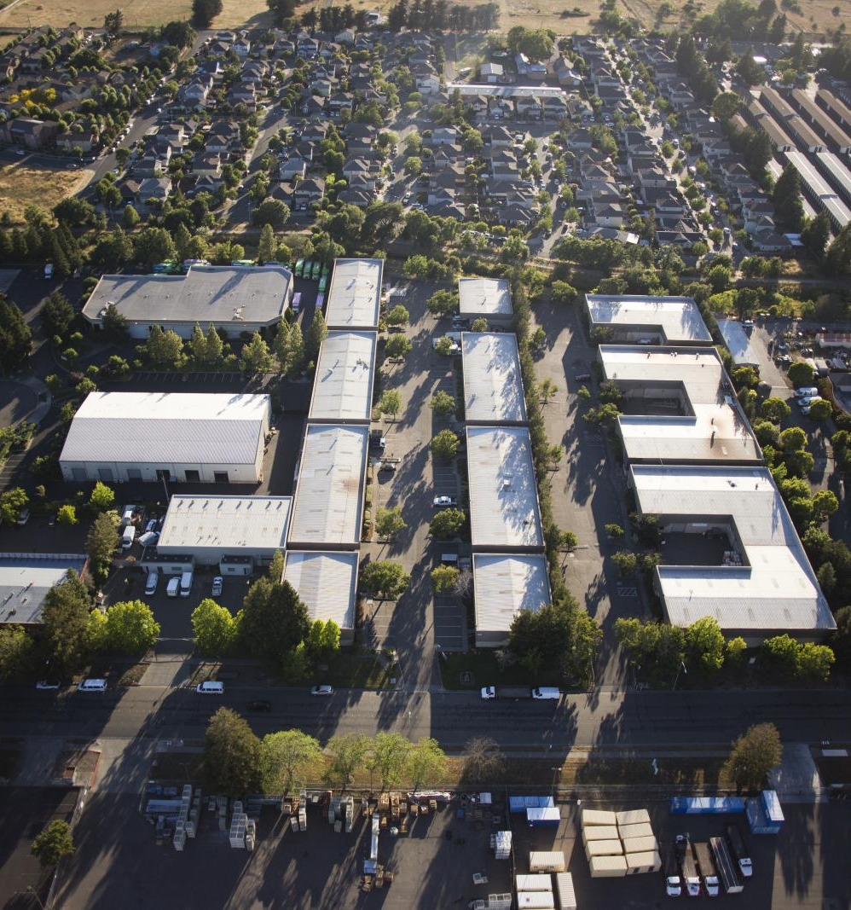
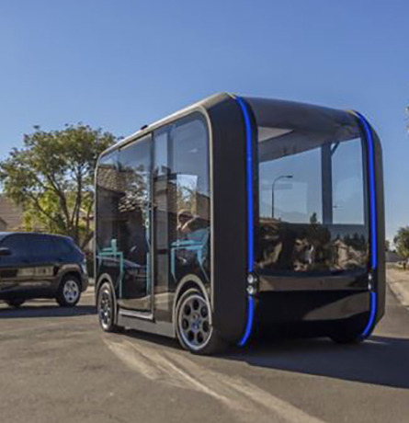
Draft Vision Statements
Successful: Top employers gravitate; Black-, Latino/Latina-, and other minority-owned businesses are in all corners of the community; tourism and entertainment spaces support a vibrant city; and meaningful work in a thriving economy is available for people of all ages and backgrounds.
Connected: High-quality, reliable, and safe transit service, bicycle and pedestrian facilities, and other forms of mobility connect all ages across the city at all times and support healthy lifestyles, clean air, equity, and resilience.

Slide 24
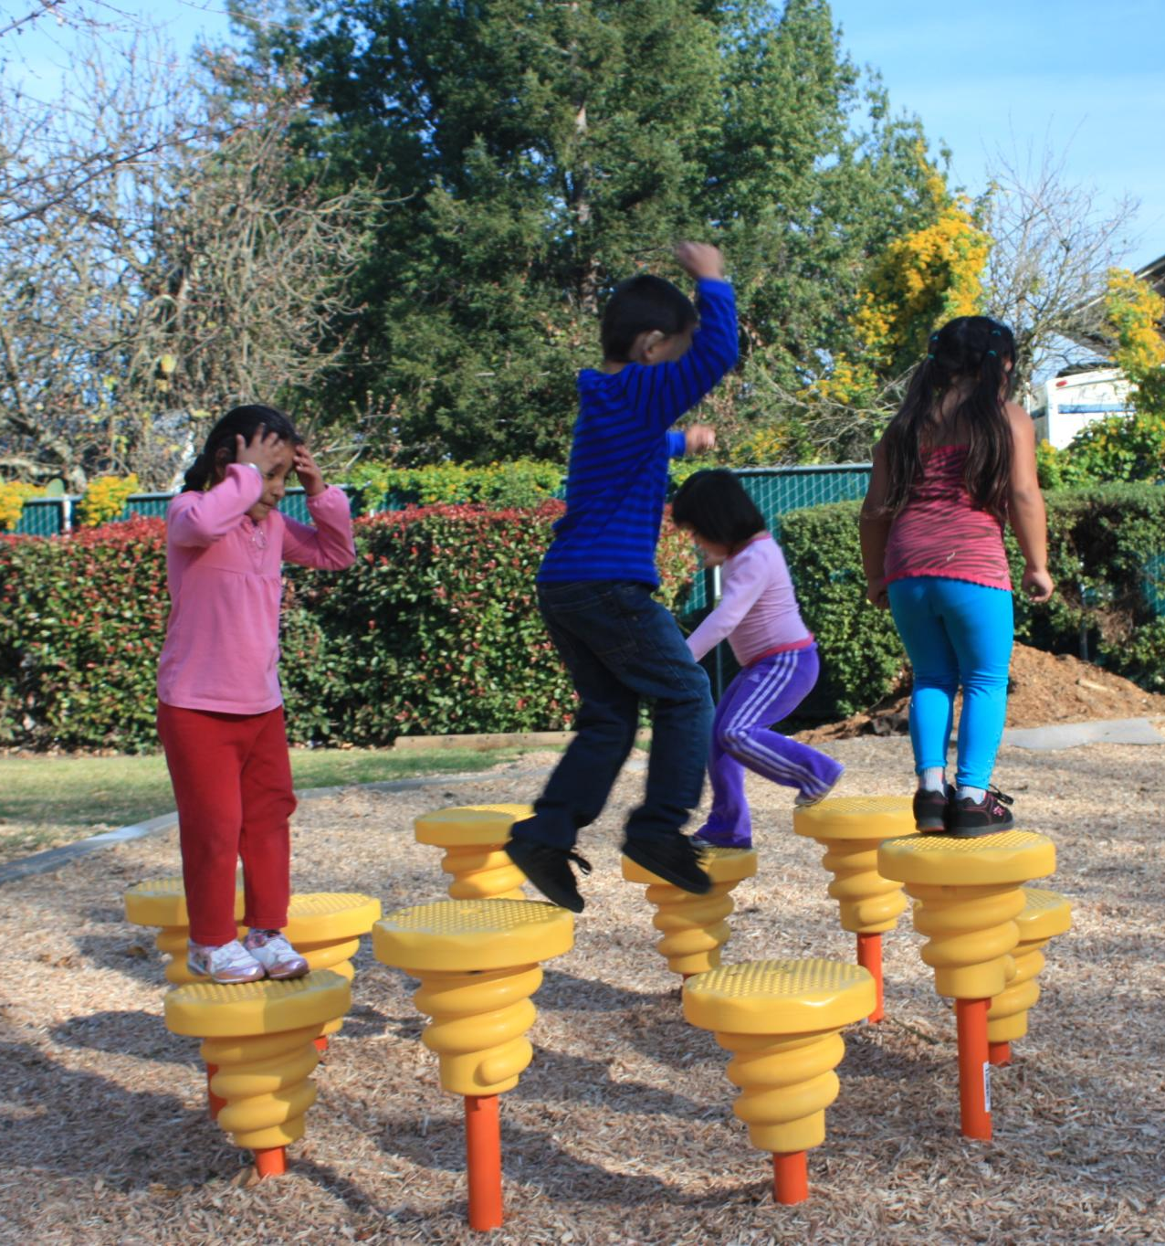
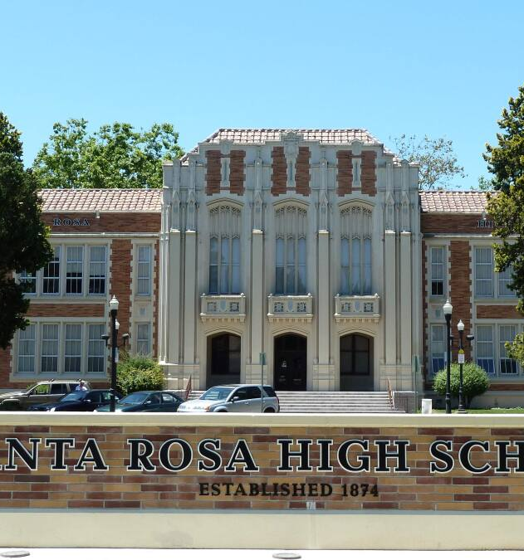
Draft Vision Statements
Safe: Public safety services are provided by caring and thoughtful community members who are representative of and familiar with the neighborhoods, groups, and individuals they serve.
Educated: Life-long education, enrichment, and supportive services and resources engage and empower young people, strengthen families (of any family structure), connect and activate seniors, and foster the success and well-being of all people.
Notes:
update

Slide 25
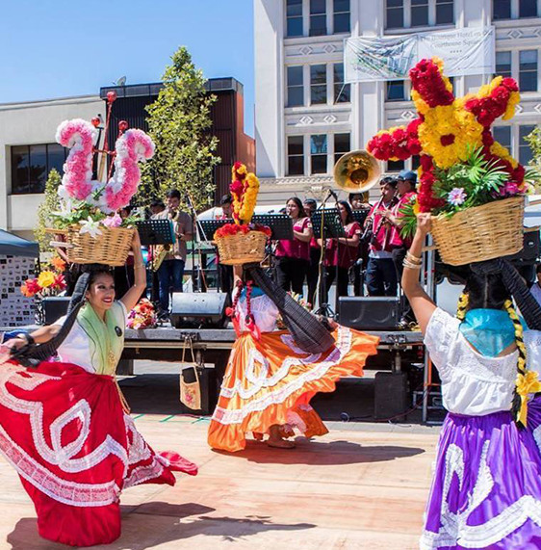
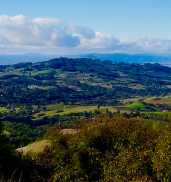
Draft Vision Statements
Cultural: Artists and public art are supported and found in every neighborhood and historic resources emphasize the importance of culture in the community and its contribution to equity and the local economy.
Sustainable: Natural resources—including streams and creeks, trees and landscaping in public places, and community and rooftop gardens—are restored, protected, and expanded to provide accessible green space for everyone in all neighborhoods.
Notes:
update

Slide 26
Questions about the project?
Notes:
Link to questionnaire

Slide 27
GROUP DISCUSSIONS

Slide 28
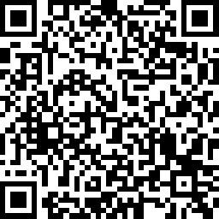
Let’s Begin!
Click on the web link in the Zoom Chat to open the online Questionnaire.
https://www.surveymonkey.com/r/59LJFM7
Notes:
update

Slide 29
Question #1
Fill out today’s date and time on the Questionnaire so we can organize all the comments.
Please also tell us a little about yourself.
Add your email address if you would like to receive regular project updates.
Notes:
update

Slide 30
Question #2
In one word, what is your vision for the future of Santa Rosa?
Notes:
update

Slide 31
Question #3
Review the Draft Vision Elements and prioritize them from #1 (highest priority) to #10 (lowest priority) based on the topics that are most important to you.
Notes:
update

Slide 32
Question #4
What do you like the most or what inspires you the most about Santa Rosa?
Notes:
update

Slide 33
Question #5
What would you change or improve about Santa Rosa in the future?
Notes:
update

Slide 34
NEXT STEPS

Slide 35
Next Steps
Save your Questionnaire and email it to: info@santarosaforward.com
The Project Team will summarize all community comments and feedback and present updated Vision Elements to the Planning Commission and City Council for feedback.
Make sure you stay involved in the process! Your ideas, feedback, and perspective is important. Please visit the project website.
Notes:
update

